Slide 1
Chapter 3 Graphic Presentation

Slide 2
The Pie Chart
A graph showing the differences in frequencies or percentages among categories of a nominal or an ordinal variable
Categories are displayed as segments of a circle whose pieces add up to 100% of the total

Slide 3
The Pie Chart
Source: U.S. Census Bureau, American Fact Finder, 2011, Table S01013

Slide 4
The Pie Chart
Source: U.S. Census Bureau, American Fact Finder, 2011, Table S01013

Slide 5
The Bar Graph
A graph showing the differences in frequencies or percentages among categories of a nominal or an ordinal variable
Categories are displayed as rectangles of equal width with their height proportional to the frequency or percentage of the category

Slide 6
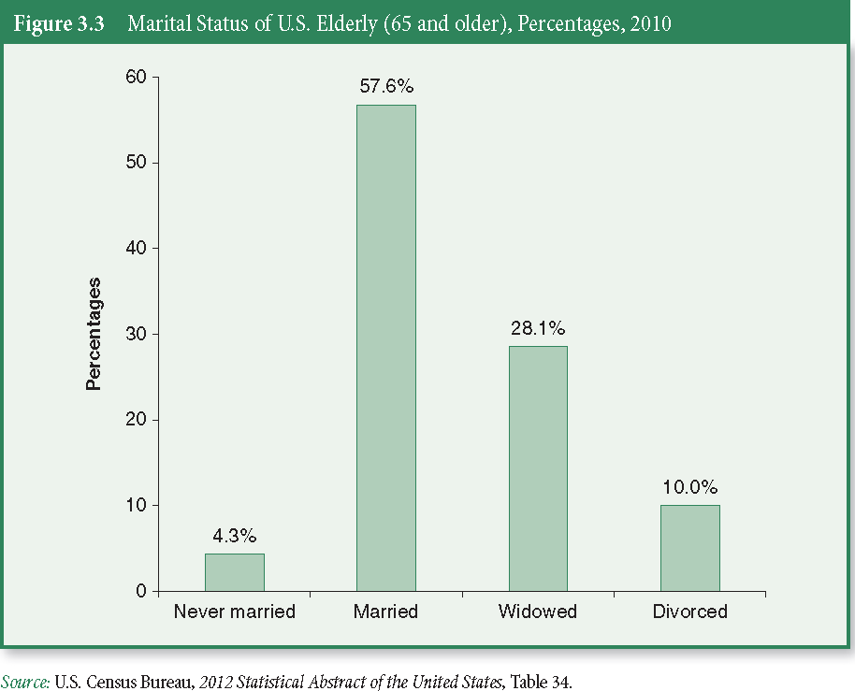
The Bar Graph

Slide 7
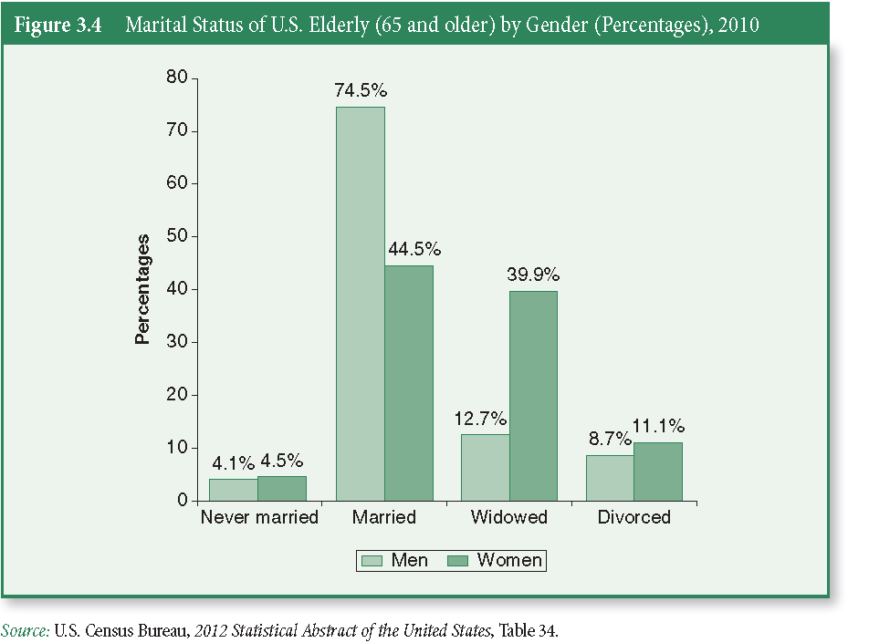
The Bar Graph

Slide 8
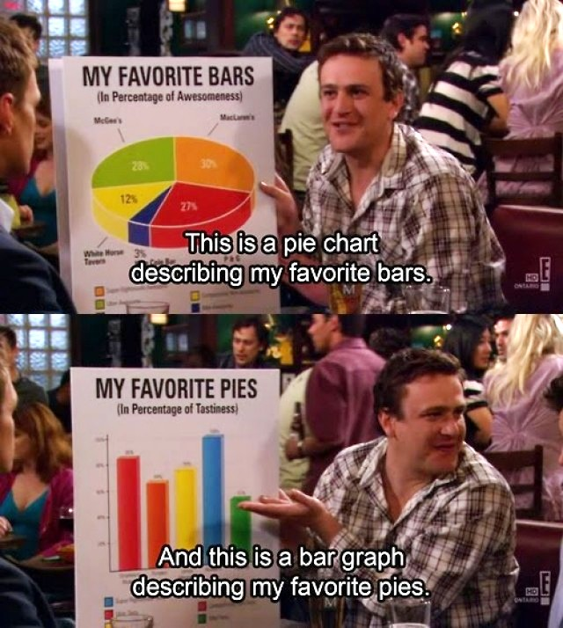
Exercise: Pie Chart and Bar Graph

Slide 9
Exercise: Pie Chart and Bar Graph
Construct a pie chart AND a bar graph to represent grade level for students in this class
Freshmen
Sophomores
Juniors
Seniors (or greater)

Slide 10
The Map
We can display geographic data using a map
Population distribution
Voting patterns
Crimes rates

Slide 11
The Histogram
A graph showing the differences in frequencies or percentages among categories of an interval-ratio variable
Categories displayed as contiguous bars, with width proportional to the width of the category and height proportional to the frequency or percentage of that category

Slide 12
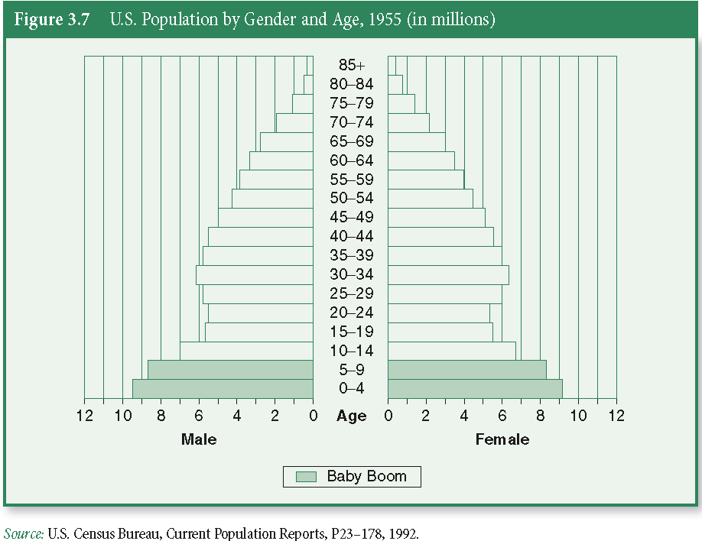
The Histogram

Slide 13
The Histogram

Slide 14
The Line Graph
A graph showing the differences in frequencies or percentages among categories of an interval-ratio variable
Points representing the frequencies of each category are placed above the midpoint of the category and are joined by a straight line

Slide 15
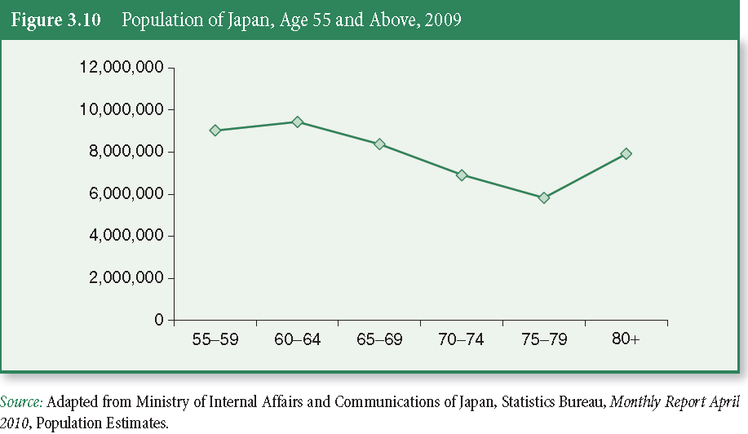
The Line Graph

Slide 16
Time Series Charts
A line graph displaying changes in a variables at different points in time
It shows time (measured in units such as years or months) on the horizontal axis and the frequencies (percentages or rates) of another variable on the vertical axis

Slide 17
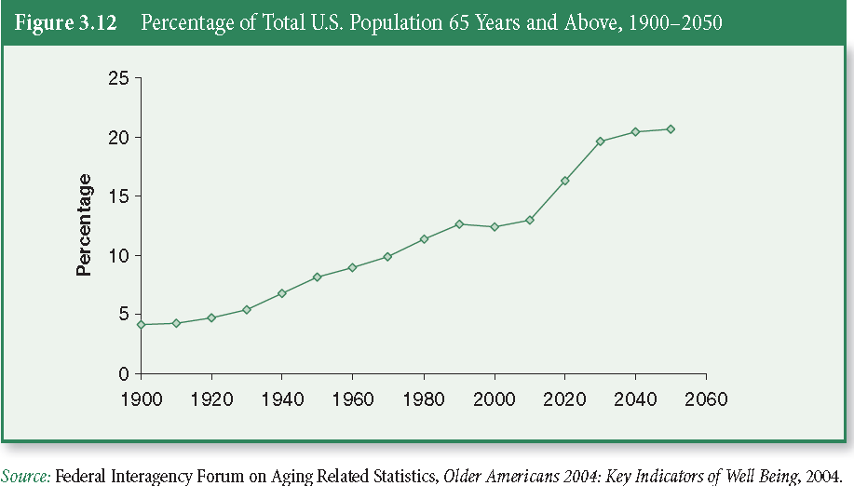
Time Series Charts

Slide 18
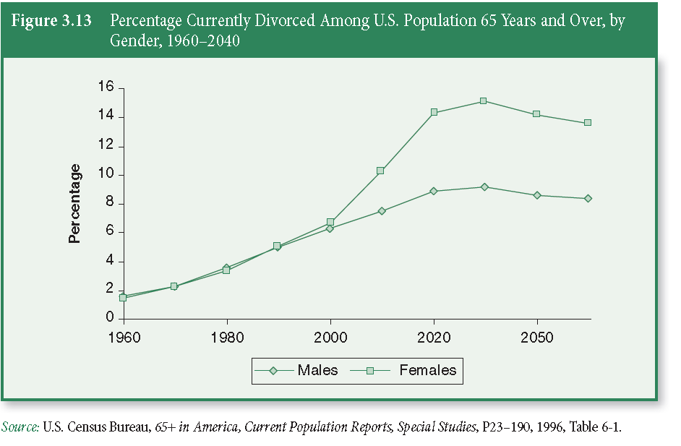
Time Series Charts

Slide 19
Distortions in Graphs
Graphs not only quickly inform us, they can quickly deceive us
Because we are interested in general impressions, we are more vulnerable to being swayed by distorted graphs

Slide 20
Distortions in Graphs
What are graphical distortions?
How can we recognize them?

Slide 21
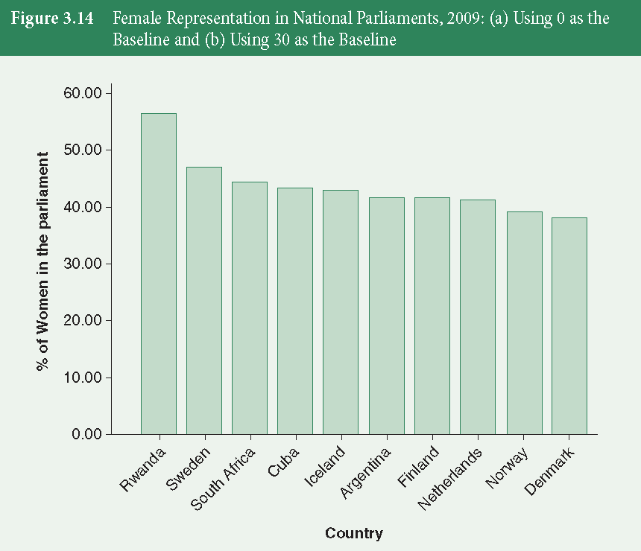
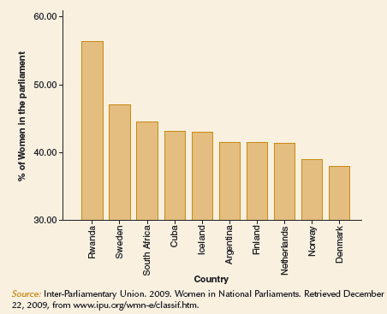
Graphical Distortions
Axes can be stretched or shrunk to create any desired result

Slide 22
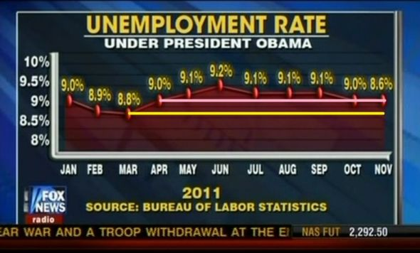
Graphical Distortions
Famous Fox News distortion

Slide 23
Statistics in Practice
The following graphs are particularly suitable for making comparisons among groups:
Bar chart
Line graph
Time series chart

Slide 24
Why Use Charts and Graphs?
What do you lose?
Numeric detail offered by a table
Ability to see additional relationships within data
Our free time
We can get caught up in selecting colors and formatting charts when a simply formatted table is sufficient

Slide 25
Why Use Charts and Graphs?
What do you gain?
Can direct attention to one aspect of the evidence
Can reach readers who are intimidated by data in a table
Can focus on bigger picture rather than minor technical details

Slide 26
Key Terms
Bar Graph
Histogram
Line Graph
Pie Chart
Time-Series Chart

